Slide 1
Effect of stop skipping on passenger travel time on the Washington Metro

Slide 2
Problem
How can reduce the time taken to travel on metros without significant investment in infrastructure?

Slide 3
Purpose
Research the effects of a skip stop system on the Washington Metro using a continuous approximation model developed by (Freyss et. al, 2013).

Slide 4
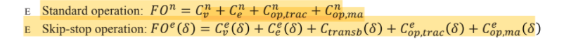
Continuous Approximation Model
This is a model that takes in various parameters, such as the the length of the track, number of trains operating, number of passengers per unit of time, station density, dwell time in every station, acceleration and deceleration rate of the train, the GDP per capita of the country (used to determine travel cost in monetary terms), and the subway cruising speed.
Has two cost functions: one for normal operation and one for skip stop operation.
These cost functions are a sum of different costs, such as transfer waiting time and travel time.
The skip stop operation function must be minimized (it is a function of the AB station density).
Cost function for skip stop operation and normal operations (certain variables are excluded)

Slide 5
Constants for cost functions
λ: station density [Stations/m]
N: number of passengers per unit of time starting a trip in each station [pax/s]
Also, we will need the following parameters:
nT: number of trains operating in each direction
a: acceleration and deceleration rate of the trains [m/s2]
vl: cruising speed of the subway [m/s]
ts: dwell time in every station [s]

Slide 6
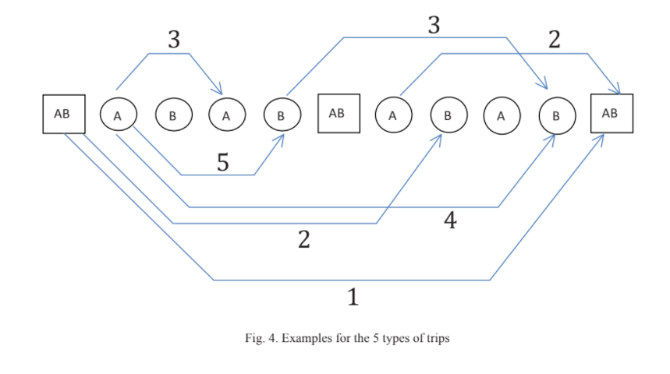
Different types of trips under a skip stop operation

Slide 7
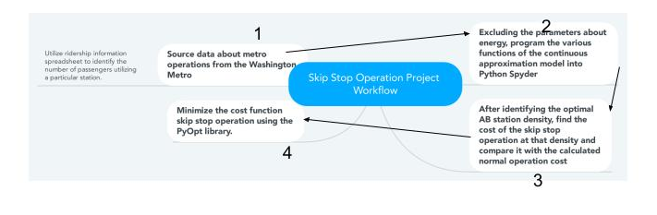
Project workflow

Slide 8
Progress
Downloaded ridership dataset from WMATA
Contains information about what destinations passengers take from each destination.
Understood premise of the continuous approximation model
The different types of trips under a skip stop operation, and why a skip stop operation can increase waiting.
Started to program some of the functions into Python

Slide 9
References
Freyss, M., Giesen, R., & Muñoz, J. C. (2013). Continuous approximation for skip-stop
operation in rail transit. Transportation Research Part C: Emerging Technologies, 36,
419-433.
Vuchic, V. R. (1976). Skip-stop operation: High speed with good area coverage. UITP Revue,
114.

